Slide 1

EVENT BOOKING SYSTEM
Aaron - Backend & Cloud
Tselmeg - Frontend & AI Integration
Aisyah - QA Testing & Validation
Hayyan - Architecture Diagram
Chalisa - Documentation & PPT Design

Slide 2
PROBLEM
&
GOAL
01
02
03
01
02
03
04
Manual booking systems are error-prone
Difficult to scale with high demand
Risk of overbooking and system failure
Build a scalable booking system
Ensure high availability
Prevent overbooking
Provide smooth user experience
Notes:
Faces in videos (e.g., replacing one person’s face with another)
• Voices (voice cloning)
• Body movements (using motion capture)
• Entire videos or speeches that never happened
✅ Positive Uses of Deepfake Tech:
• Film industry: De-aging actors or recreating actors who passed away
• Education & accessibility: Realistic dubbing, voiceovers, and translations
• Gaming & AR/VR: Enhancing realism in avatars

Slide 3
OVERALL SYSTEM FLOW
User
internet
S3
Frontend
(static content)
API Requests
(Booking,Login)
ALB
EC2
RDS

Slide 4
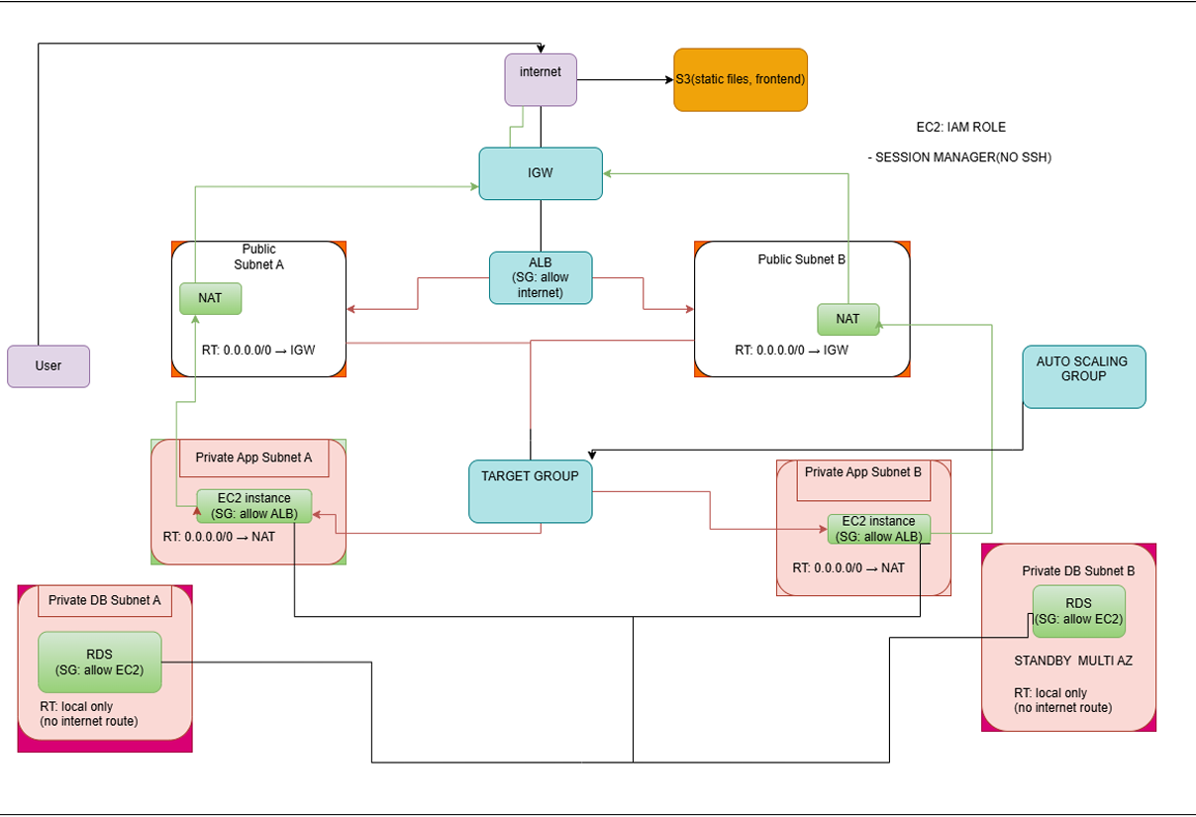
A
R
C
H
I
T
E
C
T
U
R
E
D
I
A
G
R
A
M

Slide 5
01
Browse available events
02
Book tickets
APPLICATION
FEATURES
03
Admin Dashboard
04
Prevent Overbooking
Notes:
1. (e.g., Microsoft Video Authenticator)
2. – teaching people to spot fakes
3. – laws to criminalize malicious use

Slide 6

AI ENHANCEMENTS
features
intergration
AI-assisted event description
Natural language search
Basic event interaction
Backend API integration
External AI service
impact
Improved content quality
Better user experience

Slide 7
BACKEND LOGIC
Connects frontend
to database
Processes booking and event requests
Ensures seat availibility before booking

Slide 8
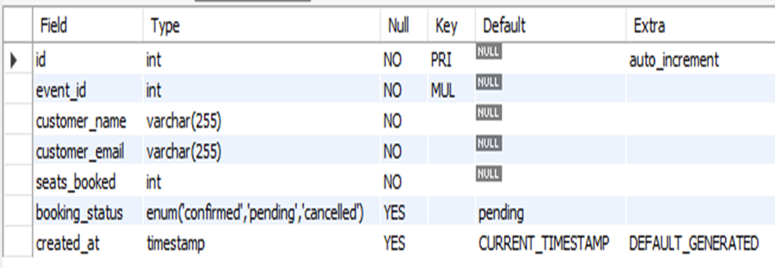
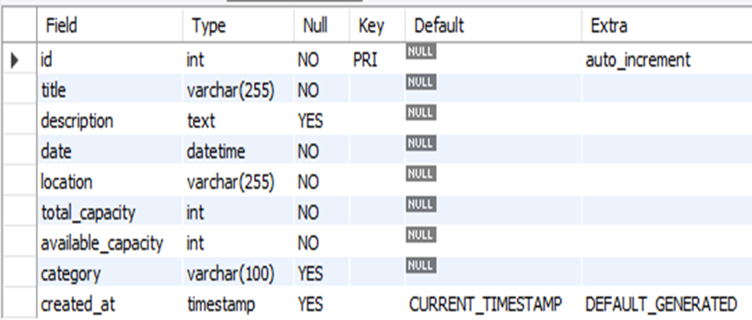
DATABASE DESIGN
01
02
03
Events and bookings stored in MySQL (RDS)
Capacity tracked to prevent overbooking
Admin credentials stored securely using
hashed passwords
booking table schema
events table schema

Slide 9
01
Backend is private
Database not publicly accessible
02
Security Groups control access
SECURITY DESIGN
03
04
No SSH (Session Manager used)
Notes:
• Generator: Creates fake content (e.g., a fake face or voice).
• Discriminator: Tries to detect if the content is real or fake.
These two systems keep improving until the fake becomes almost indistinguishable from real
media

Slide 10
CLOUD DESIGN JUSTIFICATION
ALB
distributes traffic, improves availability
ASG
replaces failed instances automatically
RDS
Multi-AZ
ensures database failover
VPC
isolates system components
SECURITY GROUPS
restricts access to resources
Notes:
• Generator: Creates fake content (e.g., a fake face or voice).
• Discriminator: Tries to detect if the content is real or fake.
These two systems keep improving until the fake becomes almost indistinguishable from real
media

Slide 11
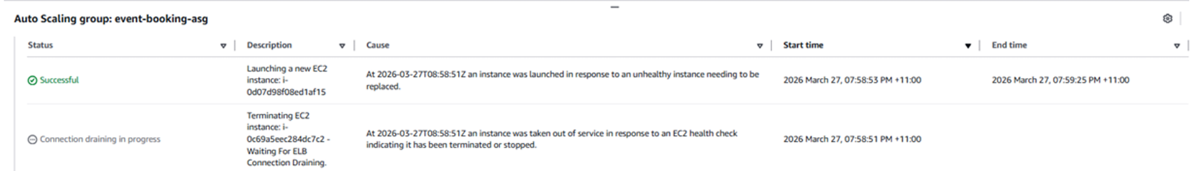
HIGH AVAILIBILITY TEST — EC2
01
02
03
Simulated EC2 failure
Auto Scaling replaced instance
Traffic continued without interruption

Slide 12
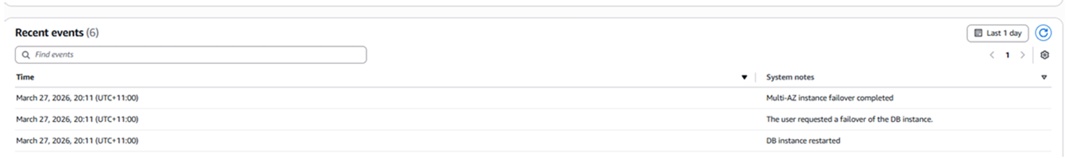
DATABASE FAILOVER TEST
01
02
03
Failover triggered using Multi-AZ
Standby instance promoted to primary
Application remained operational during failover

Slide 13
01
End-to-end booking operations remained functional
END-TO-END AVAILABILITY
02
No visible downtime to users
System remained accessible via load balancer during failures
03
Notes:
• Generator: Creates fake content (e.g., a fake face or voice).
• Discriminator: Tries to detect if the content is real or fake.
These two systems keep improving until the fake becomes almost indistinguishable from real
media

Slide 14
LIVE DEMO
03
01
Demo Flow
View admin dashboard
Browse events
02
Book an event
URL
http://event-booking-frontend-noe-2026.s3-website-us-east-1.amazonaws.com/
Backup: Screenshots available

Slide 15
Scalable cloud-based system implemented
01
High availability and fault tolerance achieved
02
Secure and isolated architecture
CONCLUSION
03
Successfully meets
project requirements
04
Notes:
1. (e.g., Microsoft Video Authenticator)
2. – teaching people to spot fakes
3. – laws to criminalize malicious use

Slide 16
Thank you very much!

